Slide 1
Create and handle
schema
Create and handle
schema

Slide 2
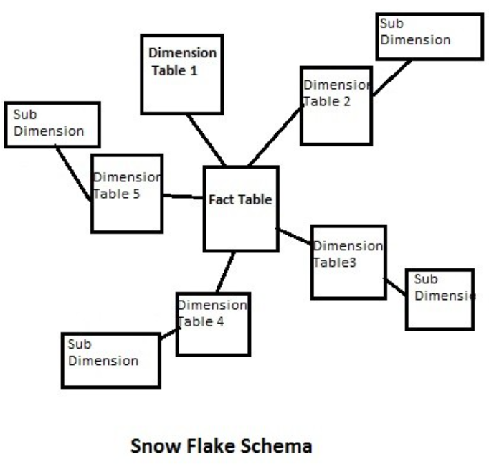
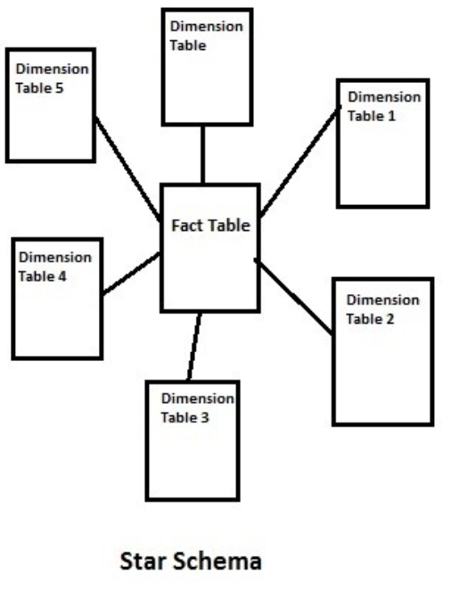
Create and handle schema
Note: This Lab uses lab2.xlsx in Sales Model
Note: The aim of this lab is to transform the Model schema from Inmon snowflake schema to Kimbal start schema

Slide 3
Manage Relationship
Start by loading the data into Power BI Desktop
Implement the Star Schema (Kimball Approach)
Model FactSales connected directly to:
DimProduct
DimCustomer
DimDate
Ensure all dimension tables are deformalized (e.g., DimProduct includes both DimCategory).

Slide 4
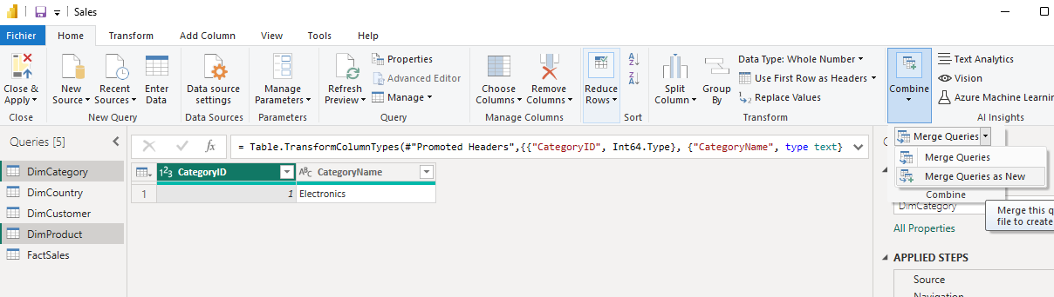
Manage Relationship
Ensure all dimension tables are deformalized (e.g., DimProduct includes both DimCategory).

Slide 5
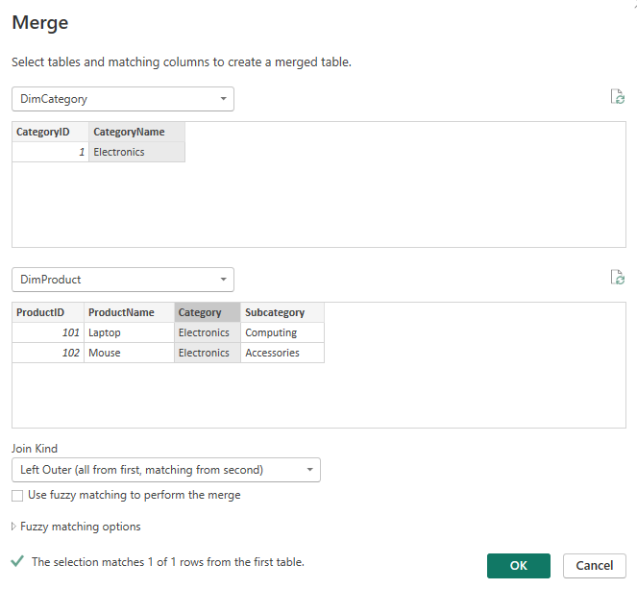
Manage Relationship
Select CategoryName from DimCategory and CategoryColumn from DimProduct

Slide 6
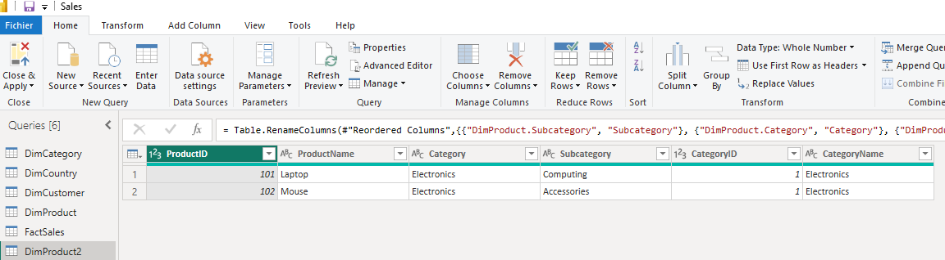
Manage Relationship
Create, clean and reshape the new DimProduct2 table to be as follow using Power Query Editor

Slide 7
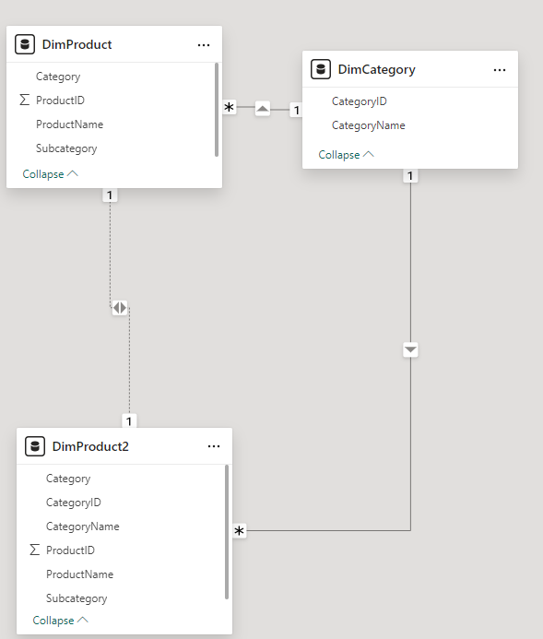
Manage Relationship
Delete both relationship if exist

Slide 8
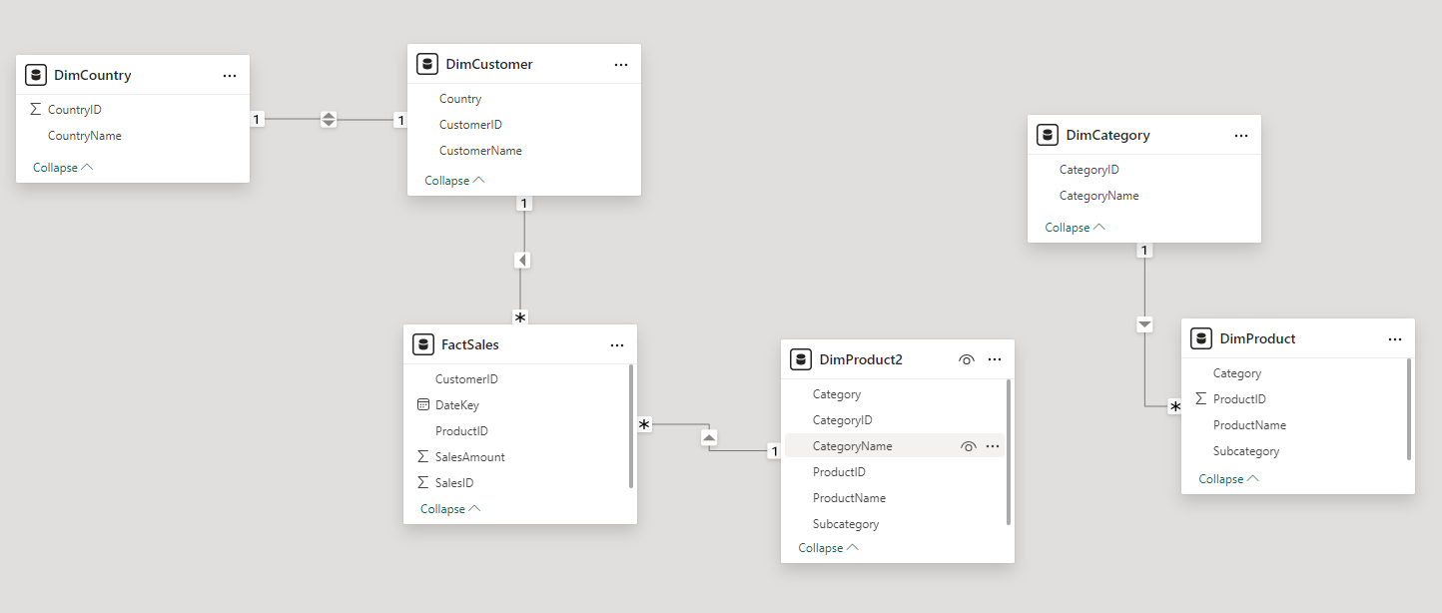
Manage Relationship
Then establish the relation between the DimProduct2 and FactSales by dragging ProductID from FactSales to DimProduct2

Slide 9
Manage Relationship
Let’s Merge DimCustomer and DimCountry and generate DimCustomer2

Slide 10
Manage Relationship
Reshape DimCustomer2 the same way as we did with the previous dimensions

Slide 11
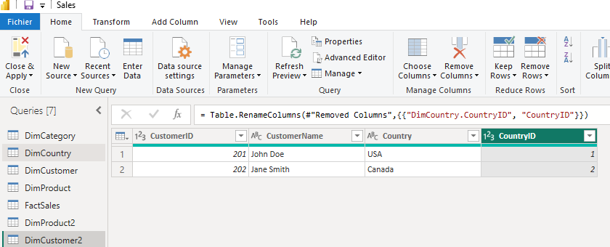
Manage Relationship
Reshape DimCustomer2 the same way as we did with the previous dimensions

Slide 12
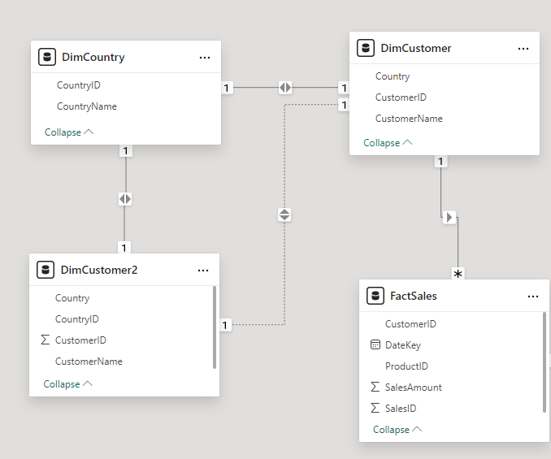
Manage Relationship
Delete relations if exist

Slide 13
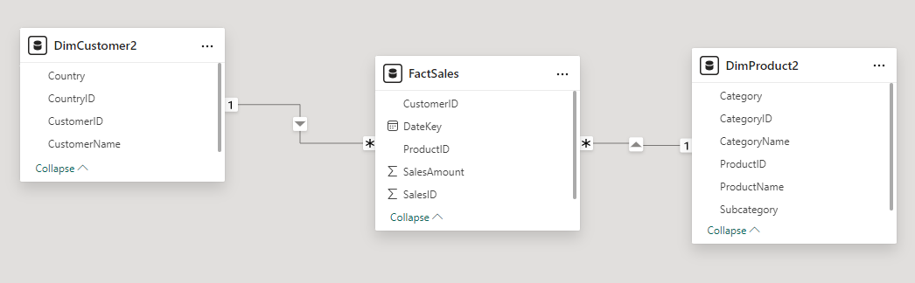
Manage Relationship
Now let’s establish a new connection between DimCustomer2 and FactSales by dragging CustomerID from FactSales to DimCustomer2, that is Kimbal Star schema

Slide 14
Thank you
Thank you

